Slide 1
Welcome to
Ms. Garrett’s Class!
Room 13

Slide 2
Ms. Garrett
I started my teaching career in 2002 working in an inner-city school in Phoenix.
I’ve taught first and second grade.
I have my master's in Education Leadership.
Fun Fact…

Slide 3

School Hours and New Arrival Information
Hours: 8:30 A.M-3:00 P.M
Students are not to be on campus prior to 8:10 (EXCEPT FOR BREAKFAST).
  The gates are not open and there is no supervision before 8:10.
  Children coming for breakfast may enter campus and go straight to the cafeteria.
Please remember that all students go directly to the classroom. We have a soft start at 8:15, and students should be in class by 8:25, with a tardy bell at 8:30.

Slide 4
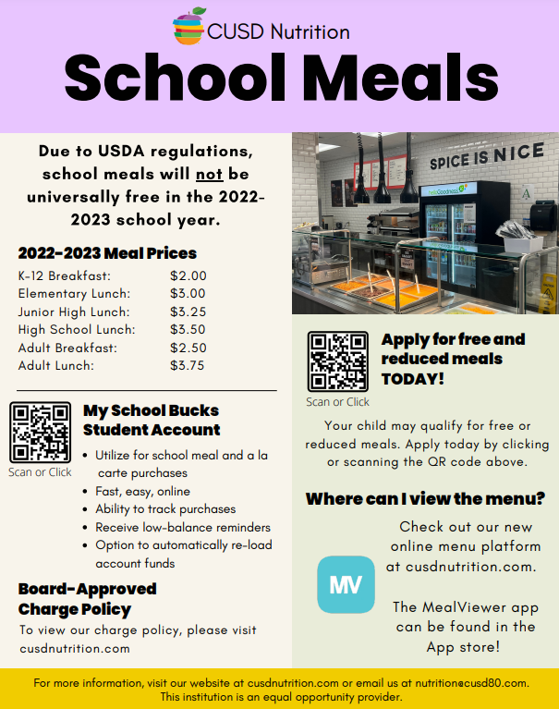
1st Grade Lunch is from
11:15-11:55

Slide 5
Student Absences
Please make sure to call our attendance line at 480-812-6203 to report your child’s absence.
Intercessions are a great time to schedule vacations, dentist, and doctor appointments. This year they are October 3rd-14th; December 23rd -January 9th; and March 13th through the 24th.

Slide 6
Student Tardies
If your child should arrive late ( after 8:30), please make sure he or she visits the office and receives a tardy slip to give me when entering class.

Slide 7
Water Bottles and Clothing
Due to the heat, it is recommended that your child dress in lightweight fabrics, preferably shorts and t-shirts.
  Girls are not allowed to wear spaghetti straps and shorts cannot be shorter than mid-thigh length.
For their safety, it is a good idea that your child wears tennis shoes, not flip-flops.
It is also recommended that your child bring a water bottle with their name on it daily. Students may have water only.

Slide 8
Newsletters
Newsletters will be in homework folders
every Friday, starting after tonight -TBD (8/9/2022).
It will include:
  indicated skills and activities that we will be covering in the week to come
  include important dates and reminders
  Have Homework listed and stapled to it
Please check your emails regularly, and purple folders daily

Slide 9

Contact Information
Open communication between us is essential to providing your child with the most productive educational experience.
Please call or send an e-mail at garrett.deborah@cusd80.com *Best way!
School office phone: 480-812-6200.
Mr. Garrett's voicemail is 480-812-6243
Messages left later than 3:30 P.M. will probably be returned the next school day. We can also set up a meeting time should the need arise.

Slide 10


Birthdays at School
Your child’s birthday is a wonderful day to make them feel “extra” special.
I gladly invite you to make arrangements with me a couple days in advance in the event that you would like to send goodies to share with the class.
Please note: We recommend small, individually wrapped snacks and/or other items may be brought to school for birthdays. Pencils, sharpeners, stickers, and erasers are possibilities
Birthday celebrations will be held the last 20 minutes of the school day in order to not interrupt learning.

Slide 11
Having Lunch with your child.
Parents and family may join their kids for lunch after first quarter (Oct. 18)
You will need to sign in first at the office.

Slide 12
Fieldtrips
First Grade will be going on 2 field trips this year.
Each field trip will cost $10
Please consider making a tax donation to Conley to help with field trips and for us to be able to get materials for the class, such as Scholastic News.
      ***Visit this site for instructions on how to submit a tax donation.
          www.cusd80.com/Page/106766

Slide 13
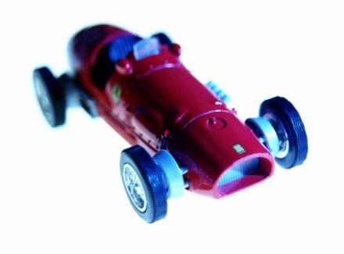
Toys
Toys are not permitted, nor are they necessary, at school.
Please do not allow your child to bring toys or valuable items to school.

Slide 14

Transportation
If for any reason your child will be going home a different way than what is indicated, you must email me garrett.deborah@cusd80.com before the start of school at 8:35.
After 8:35, please the office 480-812-6300 and they will notify me.
*** Otherwise, you child will be sent home the current way.
.

Slide 15
Classroom Rules- Second Step & "Bucket Filler"rules’-
Second-Step-Eyes watching, ears listening, voices quiet, and bodies still.Reward
"Bucket filler" says and do nice thing to make our room and school safe and happy.
Raise your hand to speak.
Raise your hand to get up
Hands to yourself
**Follow the rules the 1st time.
.

Slide 16


Specials
The schedule of the specials will be on the calendar that your child will receive every quarter.
Students must wear tennis shoes on P.E. days. Girls should wear shorts or pants.
** Put tennis shoes in backpack if you are unsure of the P.E day.** Tennis shoes are the safest shoes for your child to wear.

Slide 17


Purple Homework Folder
It is one form of communication (notes to/from me and important papers)
Homework packet will be sent home on Friday and collected the following Friday- can get ahead start for the week ahead.
The homework includes spelling practice and math.
Will start 8/12
Check these daily

Slide 18
Reading Groups
Reading groups will begin sometime around, August 15th.
A book(s) and red reading folder will start going home time –TBD. Students will be grouped according to their reading abilities.
I work on phonemic awareness, decoding, reading fluency, various comprehension activities, etc.
How to help your child at home:
Once reading groups begin, your child will be bringing home a reading folder with a book inside and reading pages( directions attached). Have your child read to you, then sign the log. Remind them to return the book to the folder and return to school the next day. Conley Elementary has high expectations for our student's reading ability. Please have your child practice reading daily.

Slide 19

Reading Books and Folders
Each reading book has a $6.00 replacement cost.
These books are directly related to our weekly focus.
* Red reading folders and purple homework folder needs to be returned daily.

Slide 20
Curriculum Online
All district and state objective can be found at www.cusd80.com (click “Site Map,” then “Curriculum Online,” then choose “Normal Access.”)

Slide 21
Help your child with writing at home by:
Ways to help your child at home:
Write simple sentences with a naming(noun) and a telling ( verb). Ex.The boy sat.
Practice writing words by saying the beginning, middle, and ending sound. Ex. Cat, pat, rip etc. Consonant verb

Slide 22

You can help your child in math by:
Make adding sentences with cereal, legos etc.
Roll a two dice and add or subtract the numbers
Add the number of plates, cups etc. on the table
Subtract cups and ask home many are left.
Count the number of cars they see
Count home many cars you see then subtract 1. 2 etc.

Slide 23


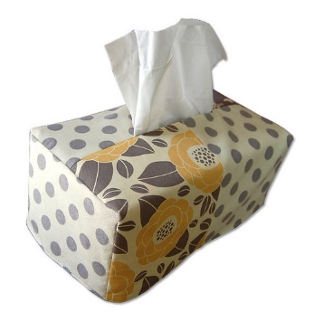

Donations
We are always in need of the following items:
Sanitizing wipes
Hand sanitizing
Tissues
Printing paper
Ear buds/Head- phones
Classroom snacks: pretzels,
crackers, fruit chews, etc

Slide 24
Where to Find Your Child’s Grades
Parents can check grades by logging into their Parent Account on Infinite Campus.
Report Cards are also sent home quarterly
https://chandleraz.infinitecampus.org/campus/portal/chandler.jsp

Slide 25

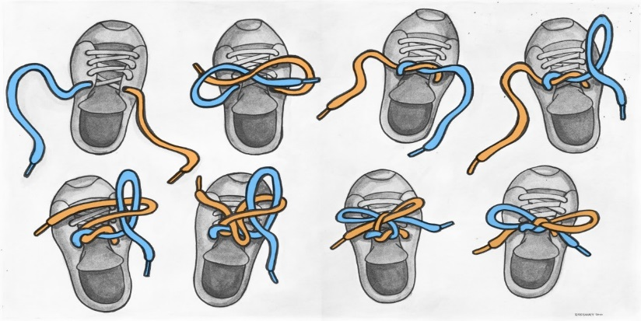
Goals for your student
Social Skills:
Students should be able to state their first and last names. Teacher’s name and room 13 as well.
Students should be able to ask the teacher/other students for things in a full sentence.
Students should be able to maintain a conversation for 2-3 turns.
Students should be able to ask and answer questions.
Students should be able to clean up after themselves and keep their area organized.
Students should be able to express to another student something they don’t like.
Students should be able to follow the class rules.
Students should accept responsibility for actions.
Students should be able to tie shoes. Double knots are encouraged.
Students should be responsibility for their actions.

Slide 26
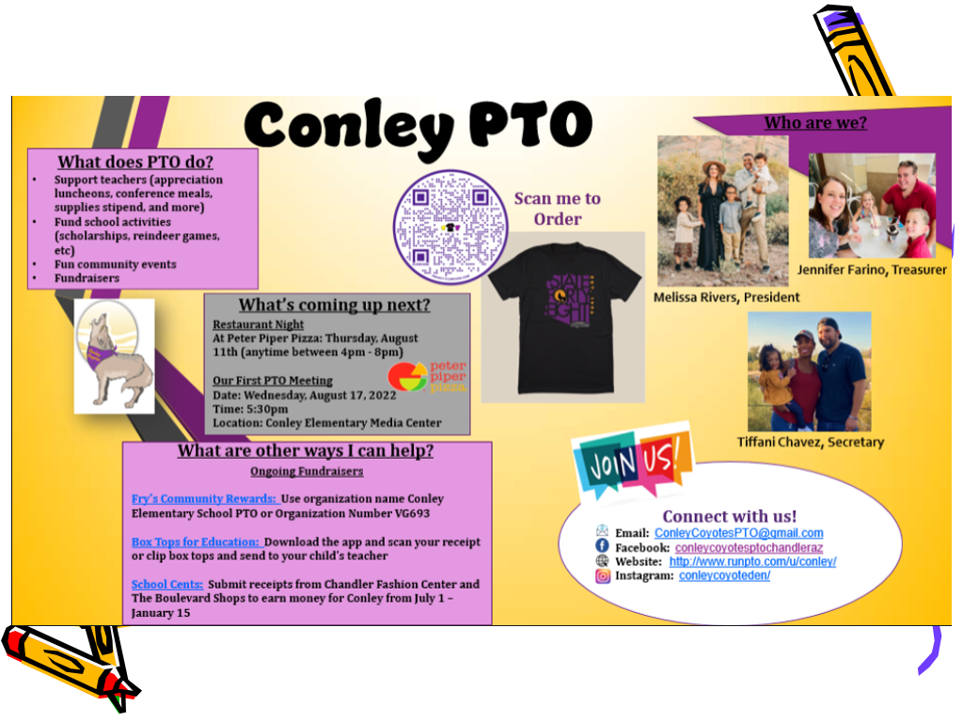

Academic Goals:
Students should be able to write their names and the dates neatly.
Students should be able to write sentences including capitals, spaces, and punctuation.
Students should know how to count to 120 and have one to one correspondence.
Students should be able to complete addition and subtraction problem including story problems.
Students should be reading at grade level by the end of the school year.
Students should be able to comprehend the story, and in written form, explain details, characters, setting, and problem/solution of the story.
Students should be able to justify answers given.
Students should be able to write and read their sight words.
Students should be able to write short paragraphs on topic.

Slide 27

Success is our goal!
Together, we can help your child to develop great skills to succeed.
Be consistent with homework and reading assignments.
Set a special place for your child to work and take time to check it.
Express interest in their work. If they see that you think it's important, then they will too and try harder.

Slide 28

Thank you!
Please email if you have been receiving my emails
Garrett.deborah@cusd80.com

